Slide 1

Space Shooter – Episode 01
Notes:
Today we’ll be creating the elements for a game.

Slide 2
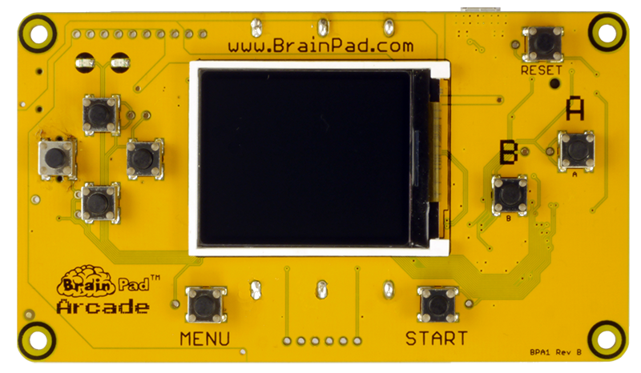

Let’s create a Space Shooter game.
Notes:
Let’s create a Space Shooter game

Slide 3
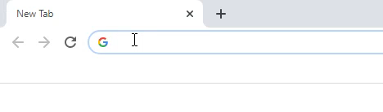
Open a web browser and navigate to…
arcade.makecode.com
Notes:
First open a browser window and navigate to arcade.makecode.com

Slide 4
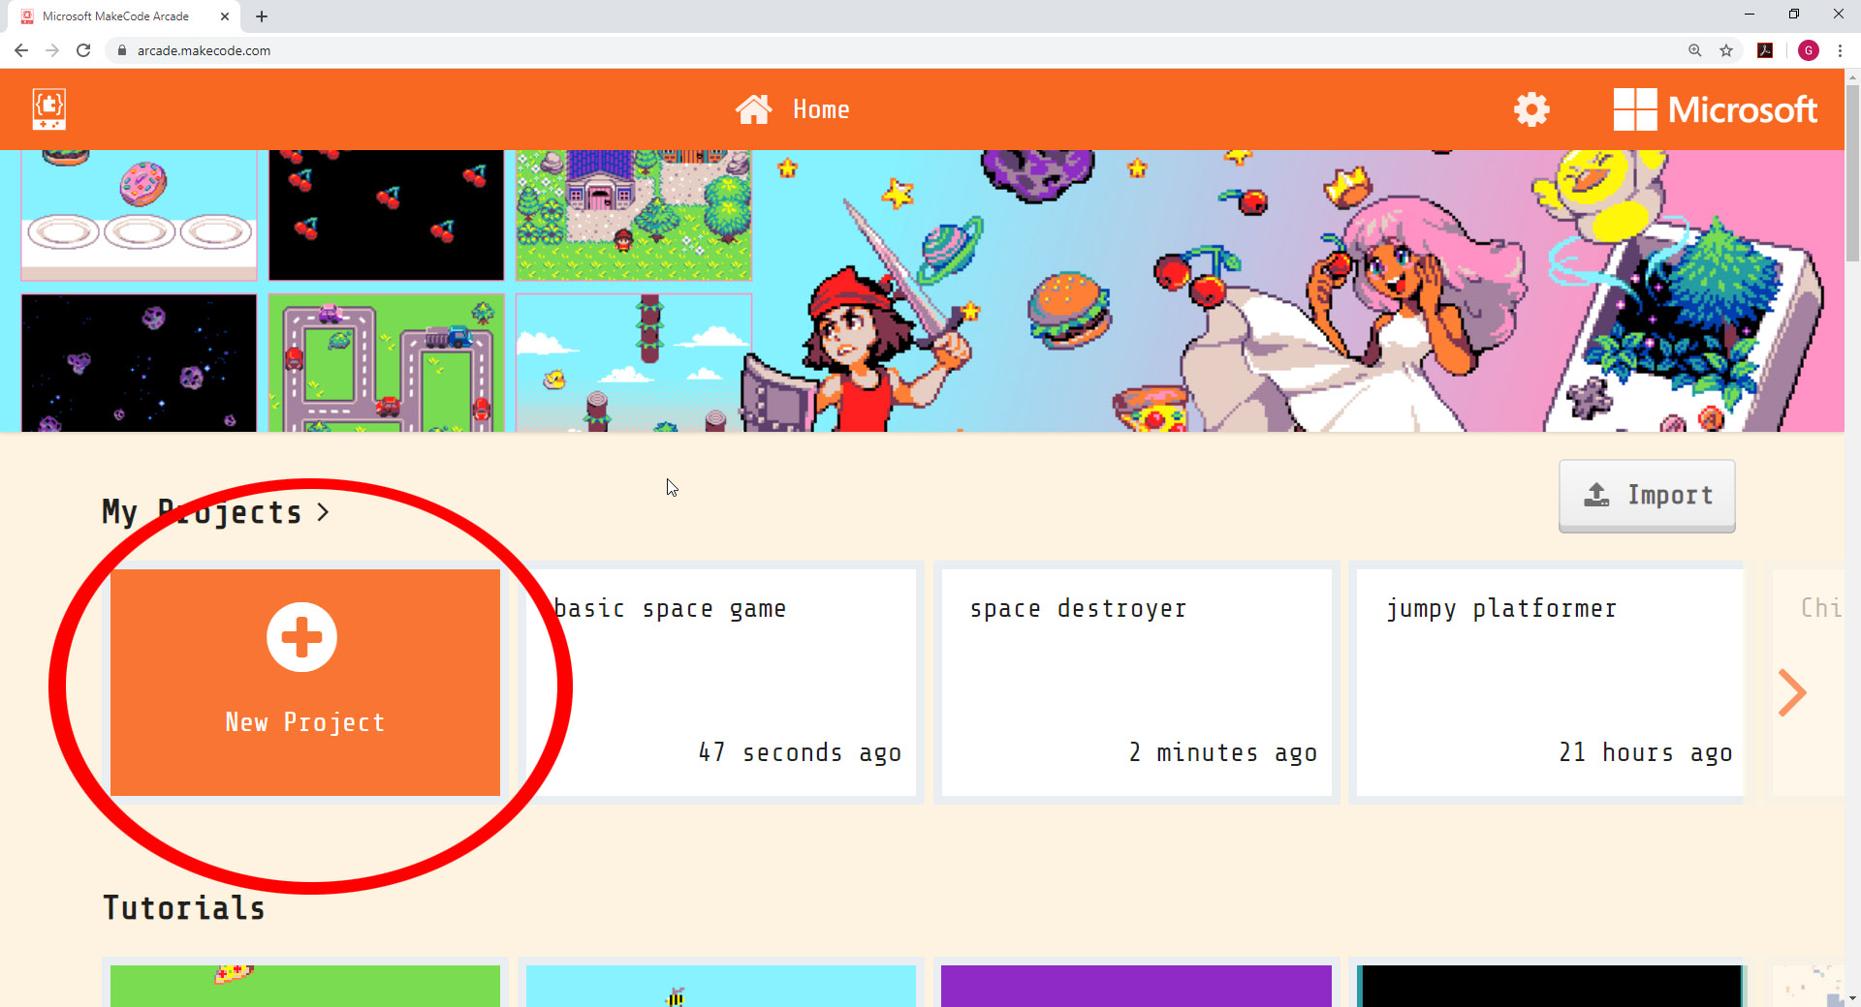
Notes:
Click on the ‘New Project’ Button, this will open a window to name our project and create a blank project for us to use.

Slide 5
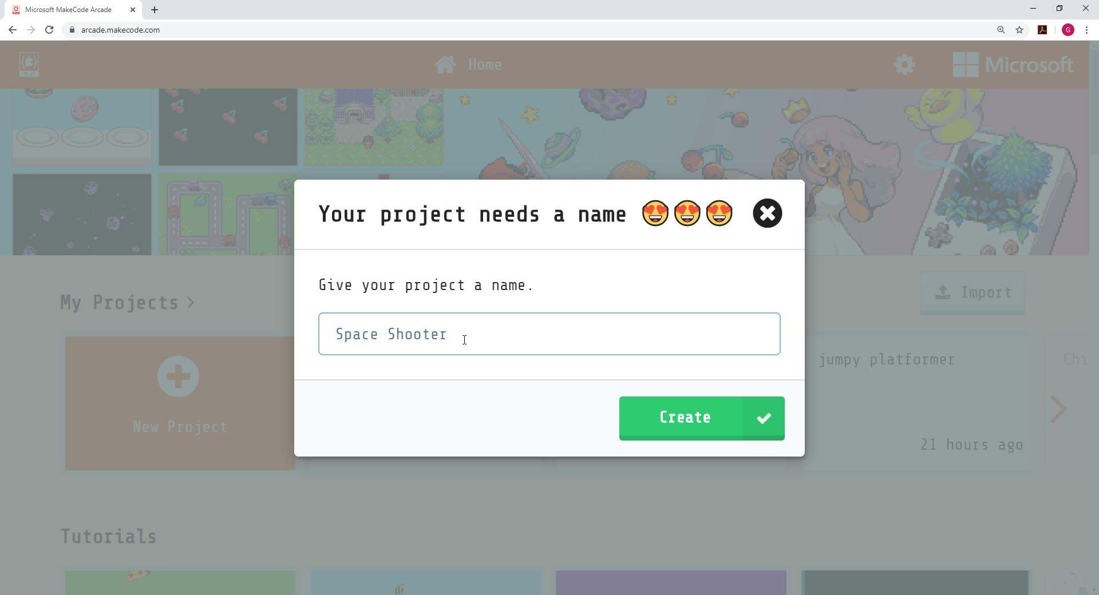
Notes:
Now let’s name the new project we’re about to create. We’ll call it ‘Space Shooter’

Slide 6
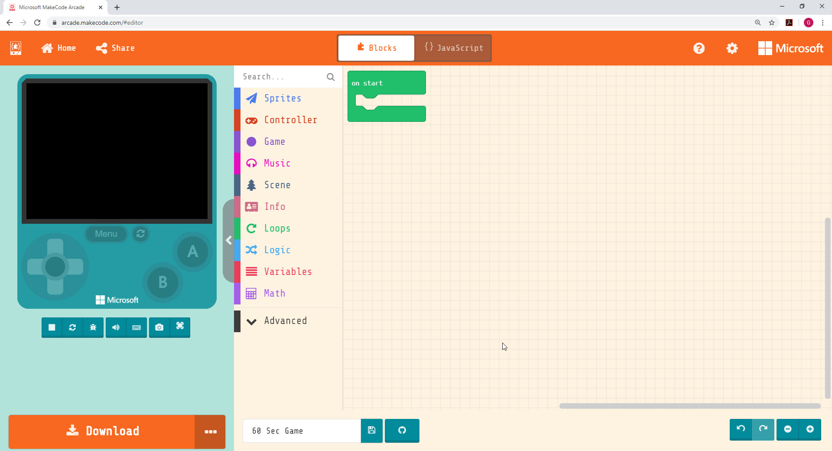
DESIGN SURFACE
This is where the game you
create will come to life!
Online Simulator
Block Menu
Online Simulator
Block Menu
Design Canvas
Download (for later)
Undo/Redo & Zoom
Design Canvas
Undo/Redo & Zoom
Download
Notes:
To change how to sprite looks, they will have to click on the white sprite box and then create their own sprite or use one from the gallery.

Slide 7


Computer Term:
SPRITE
A sprite is a two-dimensional image that is integrated
into a larger scene, most often in a 2D video game.
EXAMPLE:
Notes:
SPRITE….a sprite is a two-dimensional image that is integrated into a larger scene, most often in a 2D video game. A video game has many sprites. The player we move on screen is a sprite. Monsters or enemies that chase the player are sprites. Gold coins we might collect in a game are also sprites.

Slide 8
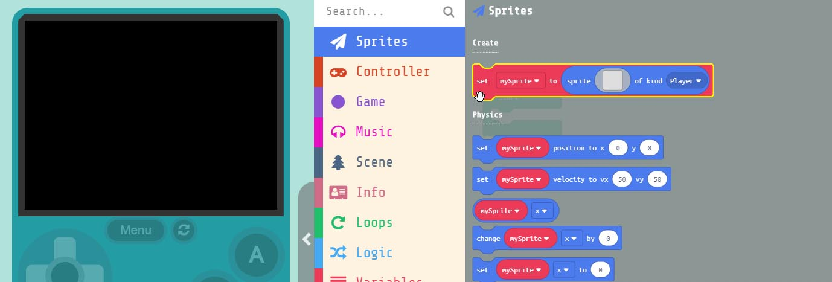
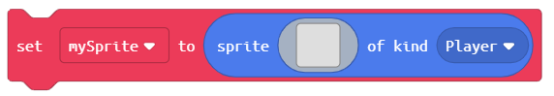
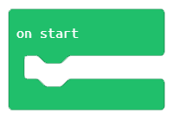
Grab the block
and drag it into the block
Notes:
Let’s create our first sprite. First we need to add a block to put our player ‘Sprite’ in. Under ‘Sprites’ in the menu, grab the ‘set mySprite to’ block and drag it into the ‘on start’ block that is already in our work area.

Slide 9
Computer Term:
VARIABLE
A variable is a letter or word, such as “x” or “score”
that represents a changing value. Variable can be named
anything but should be meaningful. To make code easier to read.
EXAMPLE:
score=score + 1
Notes:
Variable….a variable is a letter or word, such as ‘x’ or ‘score’ that represents a changing value. Variables within a program will always be changing. We can name variables what ever we want, but they should use meaningful names, so that when reading our code we better understand what’s happening inside of it. An example of a good variable name would be ‘score’. What do you think the variable ‘score’ represents? What do you think the variable ‘score’ would equal when we first start our game?

Slide 10
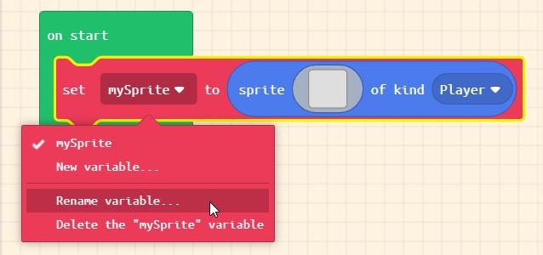
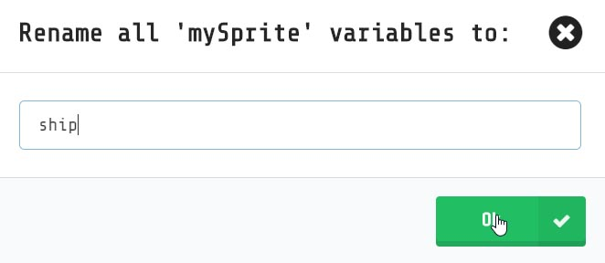
Naming our first ‘variable’
Rename ‘mySprite’
to ‘ship’
Notes:
Now let’s rename ‘mySprite’ to something more meaningful Since we’re making a space shooter game lets name the player ‘ship’. We do this by clicking on the DOWN arrow next to the word ‘mySprite’. Variables should always have meaningful names and not the ‘default’ names. What do you think the new variable we just created is going to represent in our program?

Slide 11
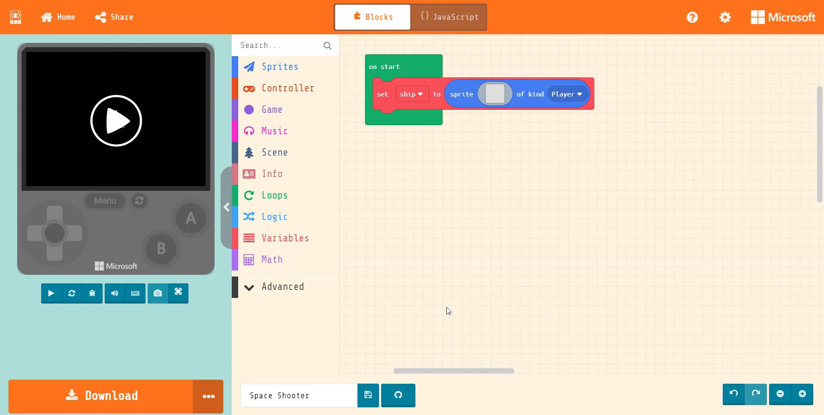
Notes:
Now let's add our Spaceship sprite to the block. To do this click on the blank gray box inside the ‘set ship’ block. This will bring up the Sprite editor. This is where Sprites are created or selected. We will grab one of the pre-created Sprites from the ‘Gallery’. Click on gallery and scroll down until you see one of the ‘Spaceships’ select it and press ‘DONE’

Slide 12
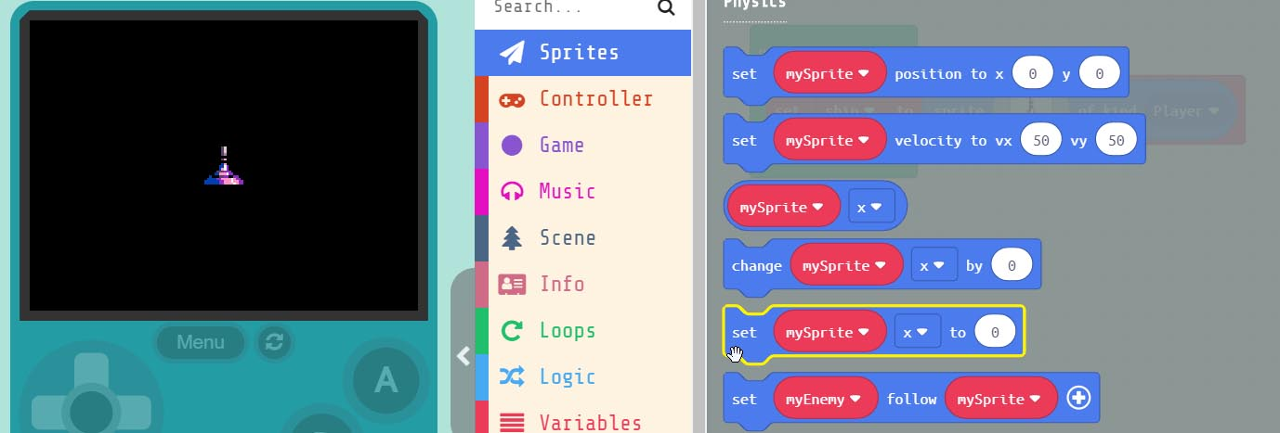
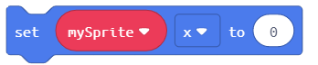
Grab the . Block
and drag it into the block just below our ‘ship’
Notes:
By default any Sprite we create is placed in the middle of the screen. We want to position the ‘ship’ near the bottom of the screen. To do this we need to select the ‘set mySprite x to 0’ block. Drag this to the ‘on Start’ block just below our ‘ship’ Sprite.

Slide 13
Computer Term:
PARAMETER
A parameter is a value that we add inside a block.
This number is passed into the block. In the example
block below ‘0’ would be the parameter. Parameters can
also be referred to as 'ARGUMENTS'
EXAMPLE:
Notes:
Parameter, a parameter is a value we add inside a block. Parameters are also sometimes called ‘Arguments’ . This number is passed into the block. In the example here ‘0’ is the parameter. Some ‘block’ can contain multiple parameters. The one is this example only contains 1.

Slide 14
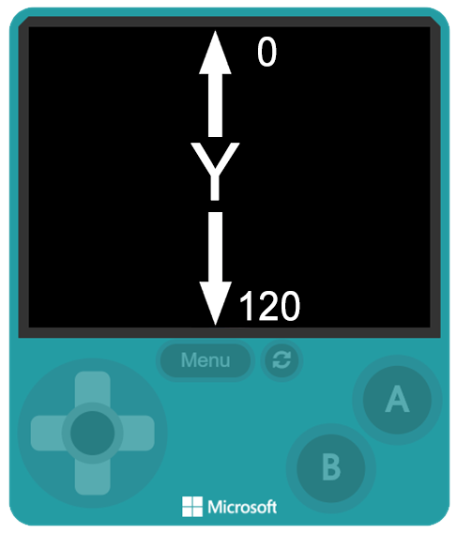
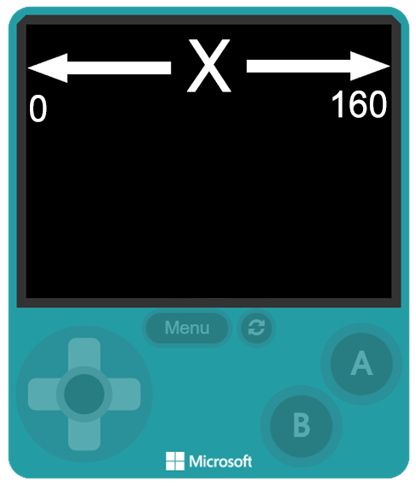
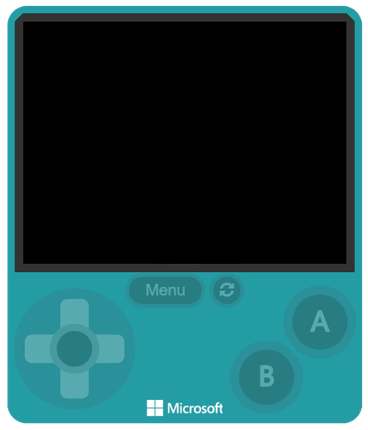
The x & y
parameters
represents
pixels on
the screen
Notes:
When we talk about the ‘x & y’ parameter? What does the x and y mean? These are pixels on the screen. The display is 160x120, which means our display consists of 19200 individual pixels. We use the x and y to define exact pixels on the screen. The x parameter starts on the LEFT at ZERO and goes all the way to the right at 160. y reads top to bottom, with the top pixel of y = 0 and the bottom pixel of y= 120. These parameters help us place and move our Sprites around the screen.

Slide 15
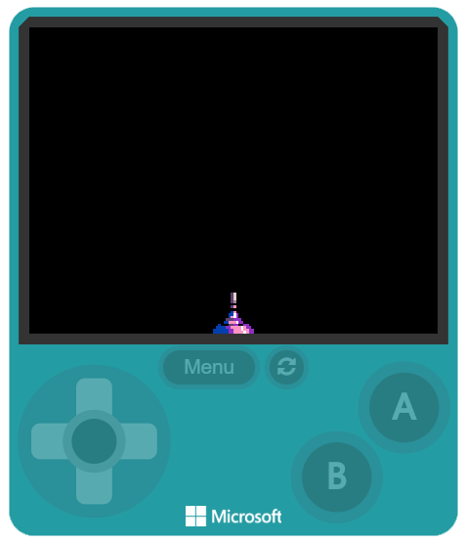
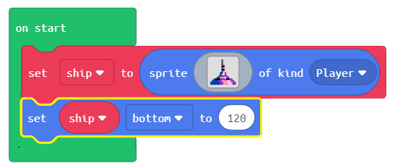
Change the name to ‘ship’
the location to ‘bottom’
and the parameter to ‘120’
This will place our ship at the
bottom of the screen or ‘y’
Notes:
We need to set the variable name to match our Sprite name which is ‘ship’, we also need to click on the down-arrow in the block and set our location to ‘bottom’ and finally the value to ‘120’. This will put our ‘ship’ at the bottom where we need it. We could also tell it to use the Y pixel, because as we noted 120 is the bottom Y pixel.

Slide 16
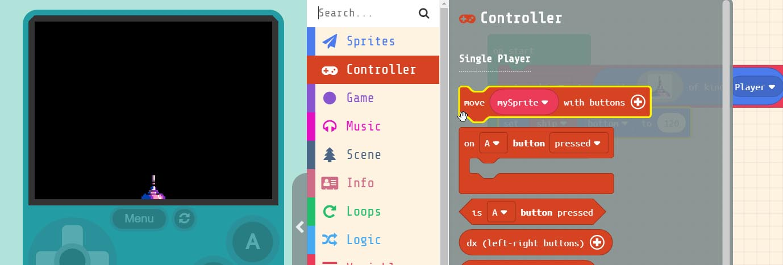

Grab the . block
Drag it into the block just below the other blocks
Notes:
Now that our ‘ship’ Sprite is located at the bottom, we’ll want to move it side to side using the LEFT and RIGHT buttons. Under ‘Controller’ in the menu select the ‘move mySprite with buttons’ block drag it into the ‘on start’ block just below the other blocks.

Slide 17
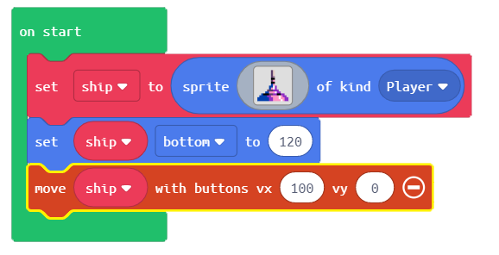
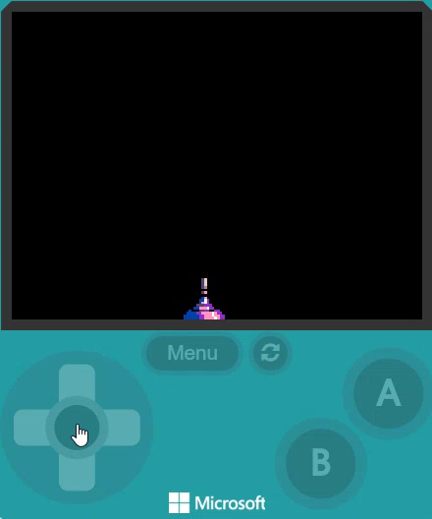
Change the name to ‘ship’
And the vx = 100 and vy = 0
Now we can move our ship
across the bottom of the screen
You’ll notice the ‘ship’ leaves
the screen
Notes:
We need to change some of the values in this block to make it work. First, we need to set it to control ‘ship’ by changing the name from ‘mySprite’ to ‘ship. Next click on the ‘+’ inside the block to reveal additional parameters we can change. Since we only need the ‘ship’ to move across the bottom we can set vx to ‘100 and vy to ‘0’. This will prevent the ship from moving up and down and only allow side to side. Try it in the simulator. You may notice that the ship can go right off the screen. We can fix that.

Slide 18
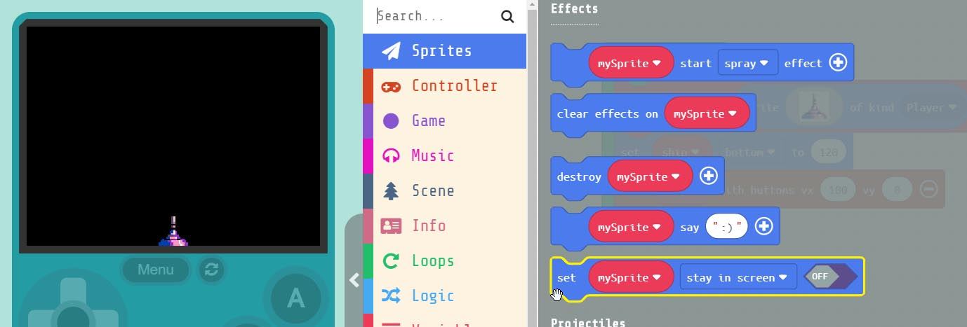
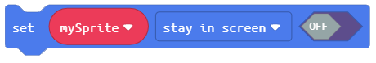
Grab the . Block
drag it into the block just below the other blocks
Notes:
Under ‘Sprites’ in the menu, scroll down to the ‘set mySprite stay in screen’ block and drag it into the bottom of the ‘on start’ block.

Slide 19
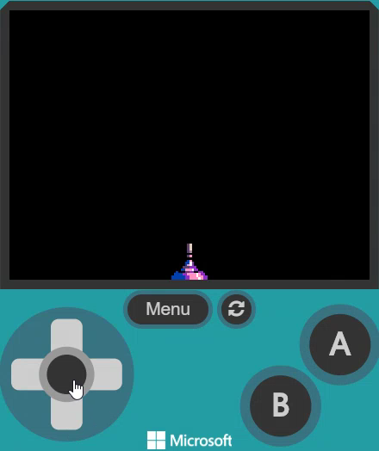
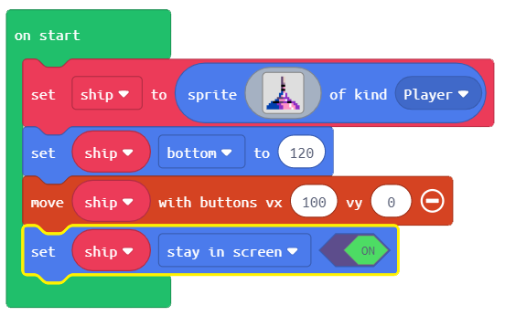
Change the name to ‘ship’
and set the block to ‘ON’
Now our ‘ship’ stays on screen
Notes:
Again, we’ll need to change the name to ‘ship’ in order to attach the blocks action to our specific Sprite. We also have to turn the block ‘ON’. Now when you move to the edge our ‘ship’ stops and won’t go off the screen.

Slide 20
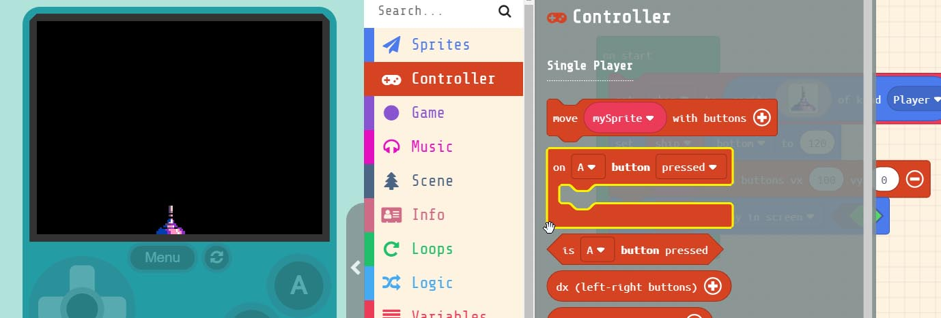
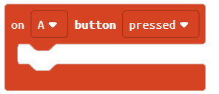
Grab the block
and drag it into our workspace.
Notes:
Now that we’ve got our ship moving let’s make our ‘ship’ shoot. To do this we need to first add a button event to our project. Under ‘Controller’ select the ‘on A button pressed’ block and drag it to our workspace.

Slide 21
Computer Term:
EVENT
An event is an action or occurrence detected by a program.
Events can be a user action like clicking a button.
EXAMPLES:
Notes:
Now you may have noticed that ‘on A button pressed’ block looks different then the other blocks. It looks more like the ‘on start’ block, like a square. This is because it’s what is known as an ‘EVENT’ block. An ‘EVENT’ block runs the code we place inside of it when an ‘EVENT’ occurs. Like a button press. ‘on start’ is an ‘EVENT’ too. The first time we run our program, everything inside of it runs.

Slide 22
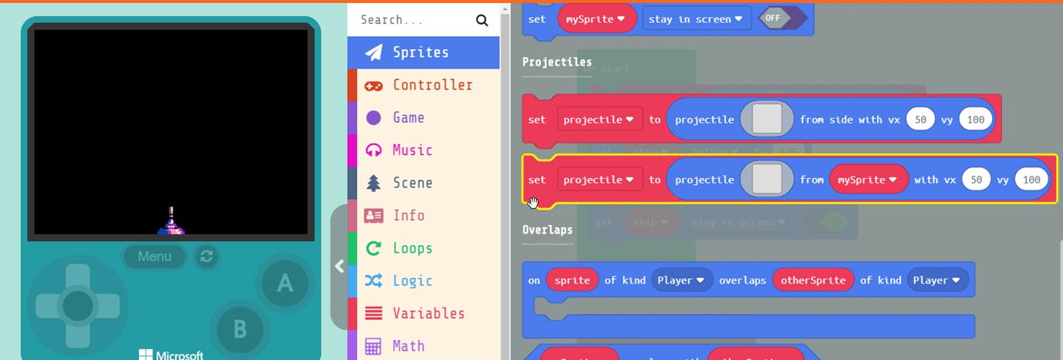
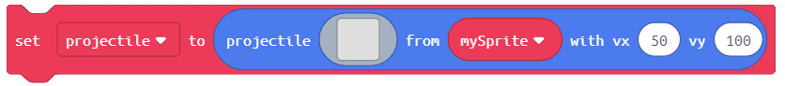
Grab the block
and drag it into event block.
Notes:
Now that we’ve got our ship moving let’s make our ‘ship’ shoot. Under ‘Sprites’ in the menu grab the ‘set projectile to from mySprite’ block and drag it into the ‘on A button pressed’ event block.

Slide 23
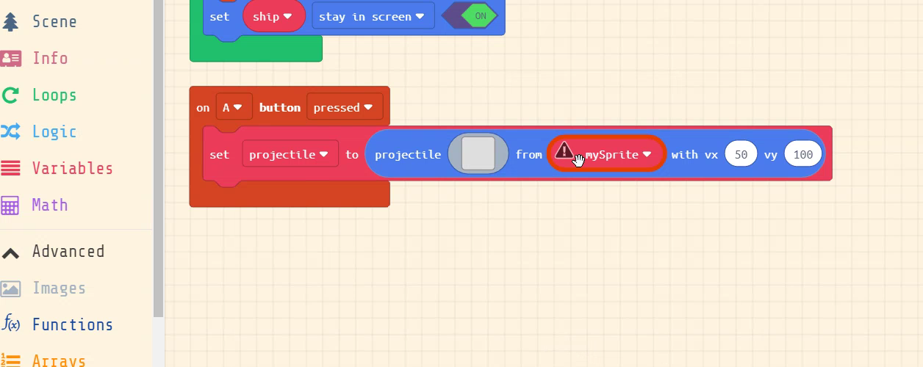
We’ll need to change some of the parameters in the block.
Change ‘mySprite’ to ‘ship’, rename ‘projectile’ to ‘bullet’,
and set vx = 0 and vy = -140.
Notes:
Now we’ll need to change some of the parameters of the block. First let's change ‘mySprite’ to ‘ship’ this will ensure that the projectile we create will fire from our ‘ship. Next, we need to rename ‘projectile’ to ‘bullet’. Finally let’s set the speed. Change the vx to ‘0’ and the vy to ‘-140’. This will make our ‘bullet’ shoot upwards along the Y-axis from the top of our ‘ship’ Sprite.

Slide 24
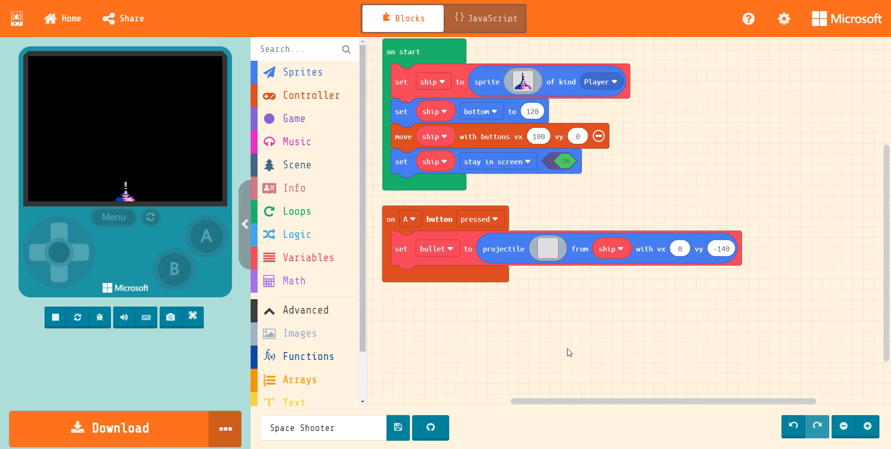
Design our ‘bullet’, click in the empty grey box inside the block.
Notes:
Now let’s create the actual ‘bullet’ sprite, click in the empty grey box inside the block. This will open the Sprite editor. He we can grab the pencil and draw our ‘bullet’ once created hit done. Then try it in the simulator by pressing the ‘A’ button.

Slide 25
Hardware Break
Now let’s load what we have on to the BrainPad.
Notes:
Now let’s load what we have so far on the BrainPad.

Slide 26
EXTRA
CREDIT
Notes:
During the EXTRA CREDIT section students are shown a snippet of JavaScript Code. They must decide which block in their program the snippet represents.

Slide 27
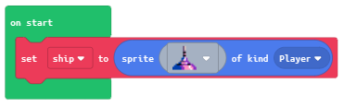
Code to Blocks:
JavaScript:
Block:

Slide 28
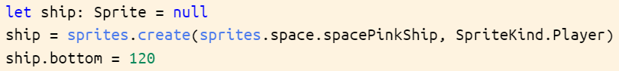
Code to Blocks:
JavaScript:
Block:

Slide 29
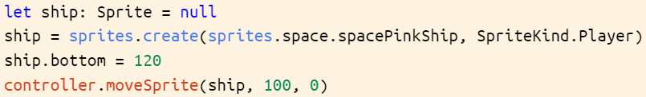
Code to Blocks:
JavaScript:
Block:

Slide 30
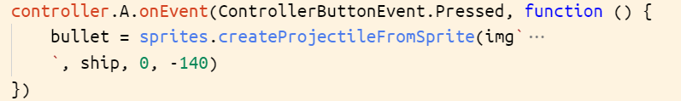
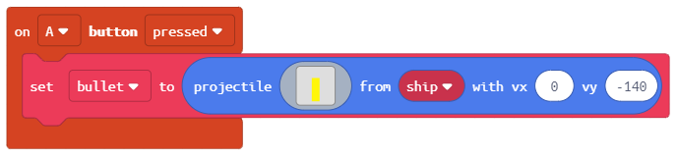
Code to Blocks:
JavaScript:
Block:

